Slide 2
Predicting Emotional Responses in Urban Environments
Master's Thesis - Elysia Gao
Notes:
Hi, my name is Elysia Gao, I am a master’s student at DTU in math modelling and computation and today I will be defending my master’s thesis on Predicting emotional responses in urban environments.

Slide 3
Context
Growing need to understand urban-emotion dynamics in real-world contexts
Emergence of "Urban Emotions" field integrating various disciplines
Limitations of existing approaches:
Limited temporal aspects in current studies
Reliance on text-based or crowd-sourced data
Lack of nuanced understanding of urban emotional landscapes
Need for interdisciplinary insights and integration of diverse data sources
Goal: Develop a comprehensive model to capture complex urban-emotion relationships and predict emotions
Notes:
There's a growing need to understand urban emotion dynamics in real-world contexts and the interaction between humans, the environment, and mobility spaces. This has led to the emergence of "Urban Emotions" as a new field, alongside the rise of "Smart Cities." The aim of studying urban emotions is to identify hot and cold spots to inform traffic and urban planning and understand the impact of transport infrastructure changes.
However, current approaches have limitations such as lacking a temporal aspect or failing to capture how emotions change over time. They also often rely heavily on crowd-sources information (user input or text information scraped online) which may not provide a complete picture. As a result, we lack nuance in understanding urban emotional landscapes.
To address these challenges, we propose adopting an approach that integrates diverse data sources and utilizes graphs to 1) develop a comprehensive model that can capture relationships between urban environments and emotions and 2) predict emotional responses in different urban contexts.

Slide 4
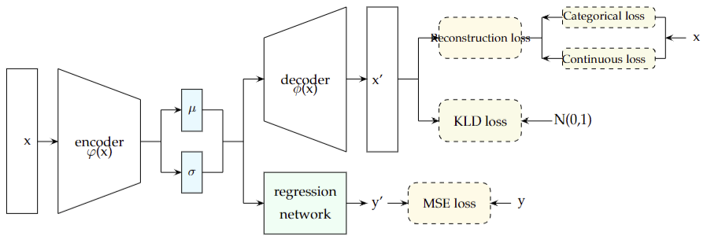
VAE with Regression Network
reconstruction
input
emotion
Notes:
Our model architecture combines a Variational Autoencoder (VAE) with a regression network to understand and predict urban emotions. Here are the key components:
VAE with GCN-enhanced Encoder: Processes graph-structured data representing daily activity patterns.
Encoder: Maps input data to a latent space, producing mean and standard deviation.
Decoder: Reconstructs input data from latent variables.
Regression Network: Predicts continuous targets (mean HR values) from latent variables.
Loss Functions:
Reconstruction loss (continuous and categorical)
KL divergence loss
Mean Squared Error loss for regression
And why do we care about reconstruction / decoder portion of our model ? To ensure that the latent representation is actually representative of the original data.
For further clarification, 90% of the data is trained on the reconstruction part where the remaining 10% is trained on the regression network.

Slide 5
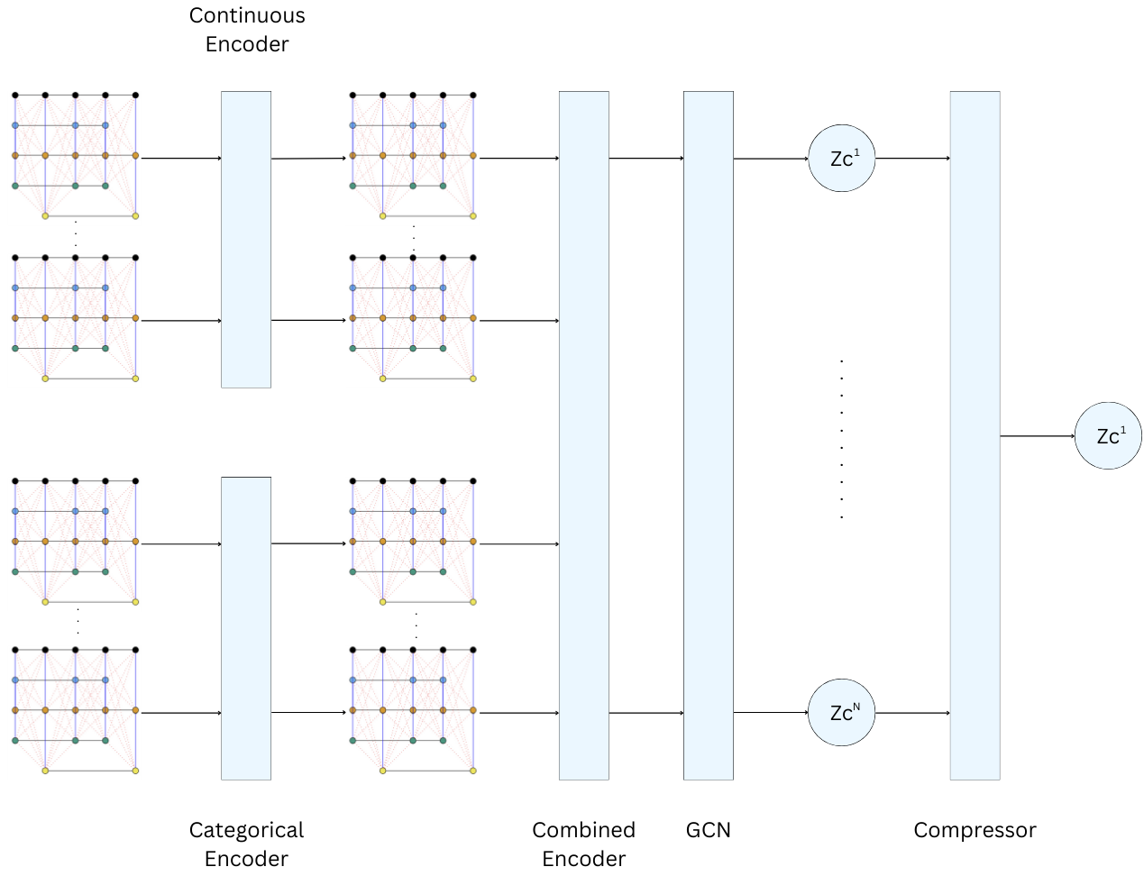
GCN-based Encoder
Notes:
The GCN encoder structure works by taking an input of a subgraph. Each subgraph is built on the input data consisting of the 5 tracks (emotions, locations, durations, activities, modes). Emotions, locations, and durations are the continuous tracks and go through the continuous encoder whereas activities and modes are categorical and go through the categorical encoder. Both embedding types are combined together and fed to the GCN (graph encoder) which processes the entire graph structure (this utilizes the stacked graph convolutional layers and captures both local and global patterns). A soft attention mechanism is also utilized at this point. Finally, the GCN representation is compressed into a single latent space.
The Graph Convolutional Network (GCN) encoder is crucial for processing our graph-structured data. Its architecture includes:
Separate Embeddings: For continuous and categorical data.
Multi-modal Encoder: Processes simultaneous events across different tracks.
Graph Encoder (GCN): Processes the entire graph structure.
Uses stacked Graph Convolutional Layers (GCLs)
Captures both local and global patterns in the data
Soft Attention Mechanism: Focuses on relevant parts of the sequence.
Latent Space Mapping: Produces mean and standard deviation for sampling latent variables.
This encoder structure allows the model to learn compact representations of daily activity patterns and emotion networks, capturing essential relationships in the data. The GCN layers are particularly important for propagating information across the graph, enabling the model to understand complex interactions in urban environments.

Slide 6
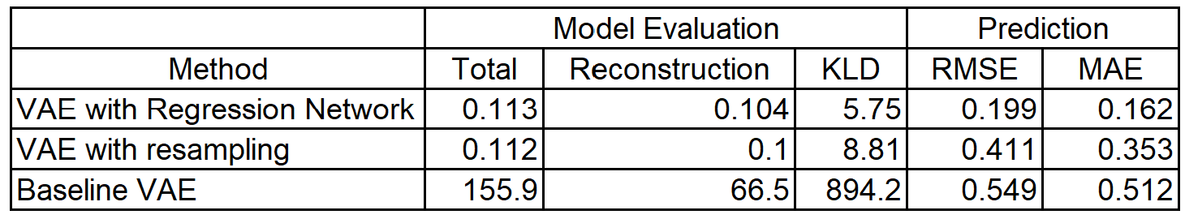
Results: Model Performance
VAE with Regression Network outperformed alternatives
Lowest RMSE (0.1989) and MAE (0.1622) in heart rate prediction
Good balance between reconstruction loss and KL divergence
Effective learning of latent space while preserving input reconstruction ability
Notes:
Our VAE with Regression Network outperformed alternatives in urban emotion prediction. It achieved the lowest error rates, with an RMSE of 0.1989 and MAE of 0.1622 for heart rate prediction. The model balanced reconstruction loss and KL divergence effectively, learning a meaningful latent space while preserving input reconstruction ability. Meanwhile MAE prediction results for VAE with resampling (same VAE model as this first method) was much higher at 0.353 and baseline VAE having the worst predictions with MAE 0.512.

Slide 7
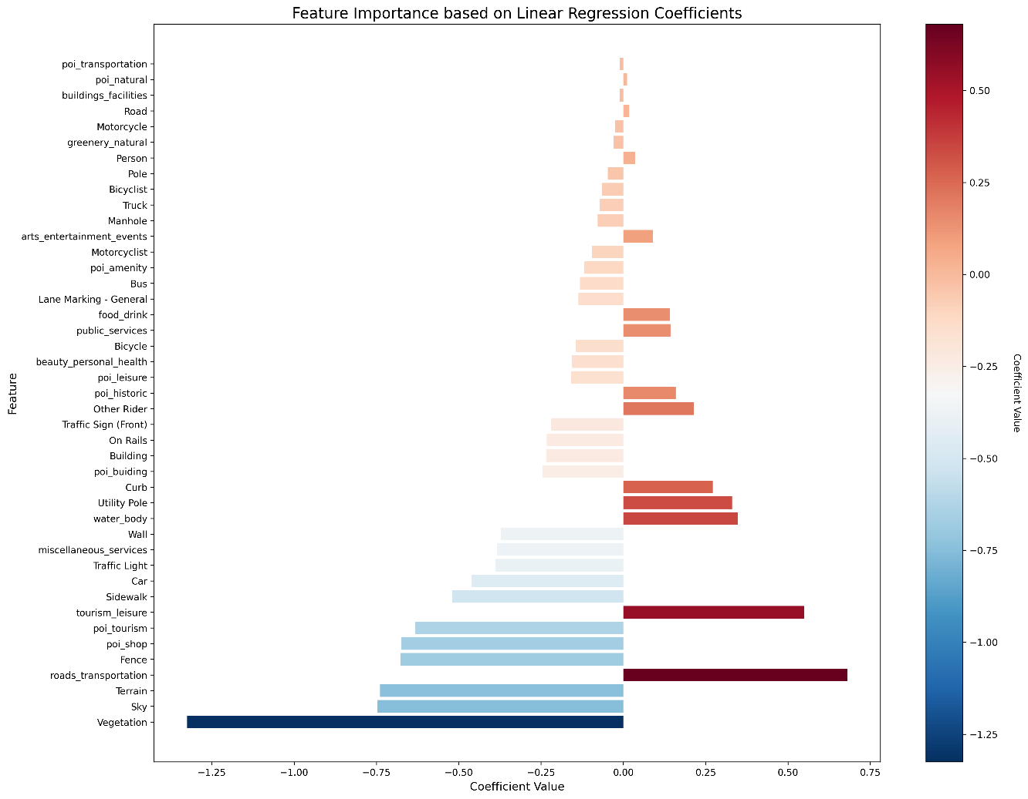
Results: Feature Importance
Notes:
This plot depicts each feature correlated with the mean heart prediction – linear regression was performed against each feature and mean heart rate prediction. High coefficient values are depicted at the bottom of the graph where features such as vegetation, sky, terrain, roads and transportation were deemed the most important.
Vegetation, sky, terrain, poi_shop, poi_tourism, fence higher negative coefficient values
Roads_transportation, tourism leisure higher coefficients

Slide 8
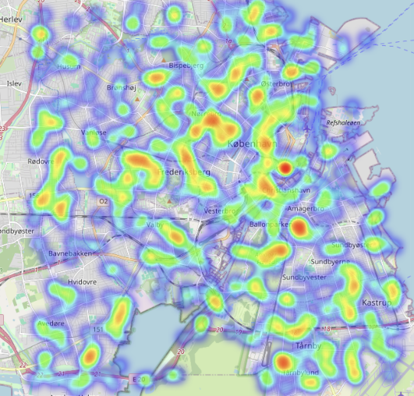
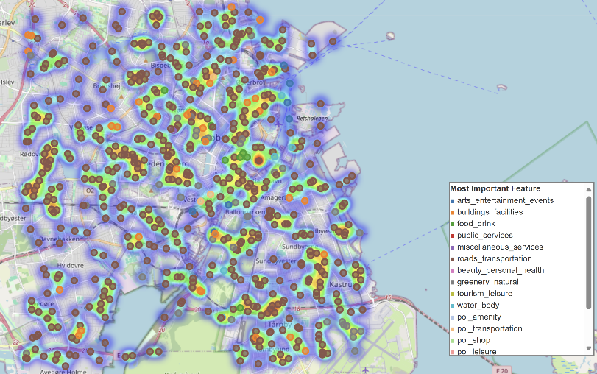
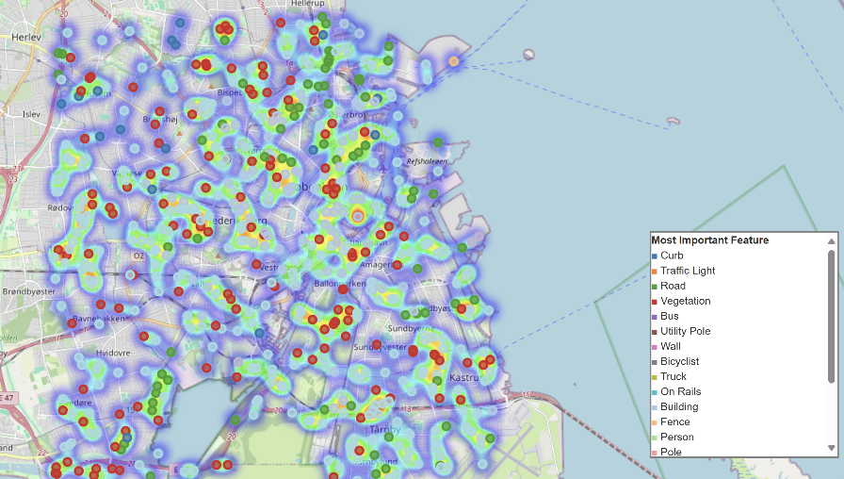
Results: Spatial Analysis
Higher rates in dense urban areas:
Frederiksberg, Vesterbro, Nørrebro
Lower rates in less congested areas
Specific zones like Christianshavn and major transit hubs showed high activity
Results reflect impact of urban congestion and lifestyle factors on heart rate
Notes:
Here, we can see heat maps of mean heart rate prediction plotted onto a map of Copenhagen. I took 590 randomly chosen locations in Copenhagen area, computed feature using data extraction, then input these location tensors through the regression network of the model to obtain the mean hr prediction. You can see some correlation with higher rates (orange/red areas) in dense urban areas and lower rates in less congested areas.

Slide 9
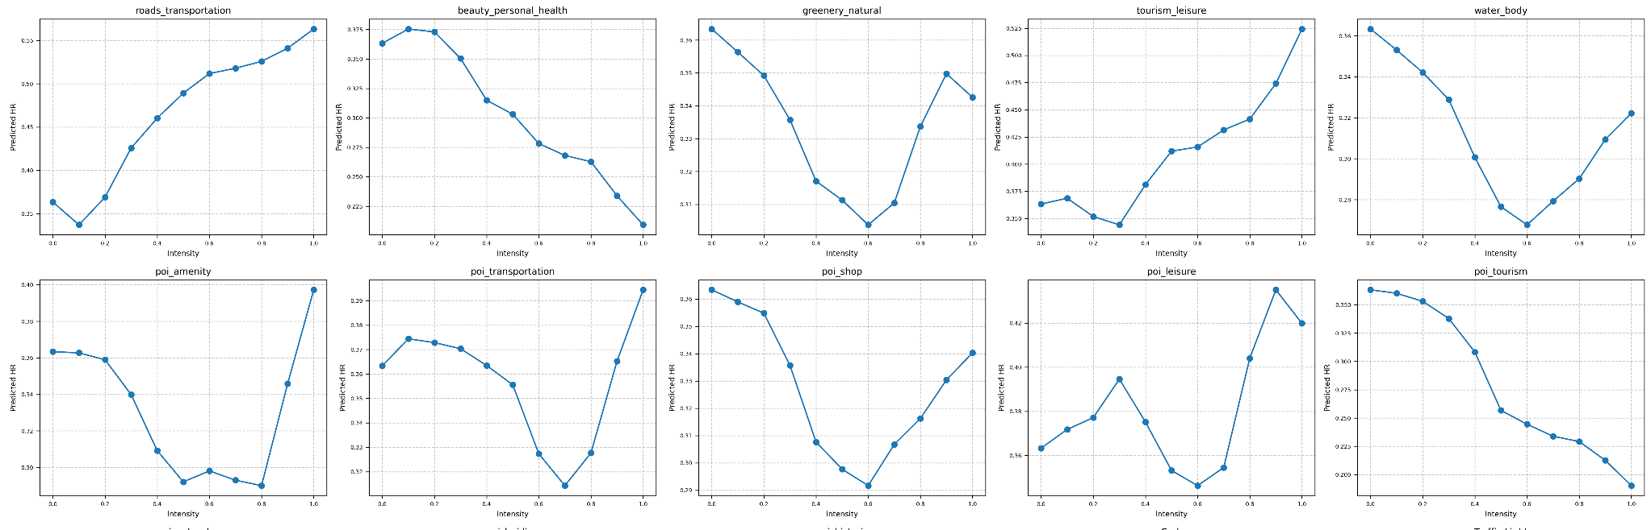
Results: Feature Intensity Analysis
Demonstrated potential for simulating urban design impacts on emotions
Urban and transportation features showed increasing heart rate trends
Natural features showed decreasing heart rate trends
Model allows prediction of physiological responses to urban design changes
Notes:
I simulated location tensors and manipulated intensity of each “feature” and input those tensors to yield predictions. This experiment showcases how we could simulate urban design impacts on emotions – you can see urban and transportation features such as roads_transportation show increasing heart rate trends whereas beauty personal health, greenery natural, water body show some decreasing trends to an extent.

Slide 10
What Could Have Been Done Better
Focus was on building appropriate model architecture, but improvements possible in:
Problem specifics
Data investigation
Parameter tuning
Enhancing representation of emotions
Explore more nuanced emotional indicators
Why these improvements matter:
Could lead to more accurate and comprehensive results
Better alignment with real-world complexity of emotions and urban environments
Notes:
Majority of time spent was on building an appropriate working model architecture, however, improvements could be made to further refine the specific problem in order to receive more conclusive and representative results. Examples of improvements could be exploring problem specifics and data investigation (looking at days were participants are mostly at home or splitting up the dataset into weekdays and weekends), parameter tuning (split between how much data was trained with reconstruction vs regression network, number of layers), enhancing representation of emotions (original intention was to use valence and arousal measures form the physiological data built by a phd student but ran out of time). These improvements would lead to more accurate modeling and hopefully better results.

Slide 11
Approaching the Topic Anew: Lessons Learned
Investigate different model architectures from the start
Avoid being married to a single idea
Focus on fitting architecture to purpose, not vice versa
Begin with comprehensive literature review
Read surveys on graph embedding structures and VAEs
Select most appropriate category, then develop specific model
Improve debugging and validation process
Use print statements to verify input/output dimensions at each step
Enhance iterative approach
Continue making adjustments and observing results
Implement better version control
Keep detailed track of adjustment results
Notes:
Some lessons learned for the thesis included investigating different model architectures from the start and not being married to a single idea. Originally, the project started off looking heavily into the node2vec approach, then devolved in various music models. I think it would have been good to start off my broad then go specific then vice versa. Similarly with literature review, I had found looking at surveys of different topics a little later when it would have benefitted me more at the start. Lastly, while debugging, implementing better version control and keeping detailed log of results would have been helpful as well.

Slide 12
Problems and Lessons Learned
Issue: Each timestep contained too much redundant data
8 hours to run just 7 participants
Solution: Aggregated emotions data
Lesson:
Importance of efficient data representation, consideration of what data looks like (sparsity), redundancy etc.
Need for thoughtful data aggregation in time series analysis
Notes:
Specific issues and lessons learned are as follows. One of the first issues I ran into was each timestep containing too much redundant data and having too many timesteps. At first I was using the entirety of the heart rate data which contained sample rate per second where I would have 40000 data points per day per participant. This led to a run time of 8 hours to run my model on just 7 participants. The solution was aggregate the emotions data with summary statistics. Lesson here was to consider more efficient data representation and consider things like redundancy and sparsity while building my model.

Slide 13
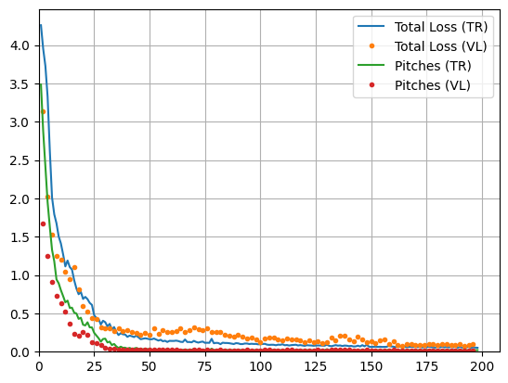
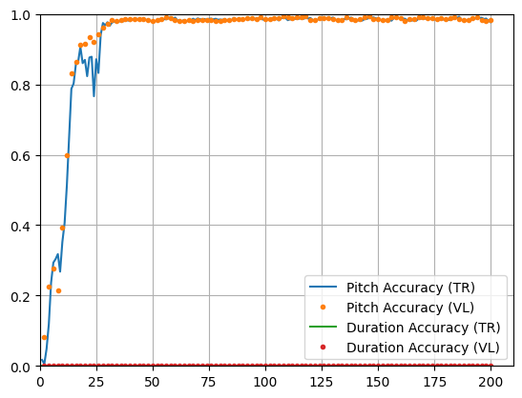
Problems and Lessons Learned
Issue: Errors were unexpectedly small
Action: Led to further investigation and model improvements
Lesson:
Importance of critically evaluating results
Value of skepticism in model performance analysis
Notes:
Another issue was error was suspiciously small. This had led to further investigation and model improvements – taking a closer look at continuous and categorical losses separately and training them separately. The lesson here was to carefully evaluate results even though they may be good.

Slide 14
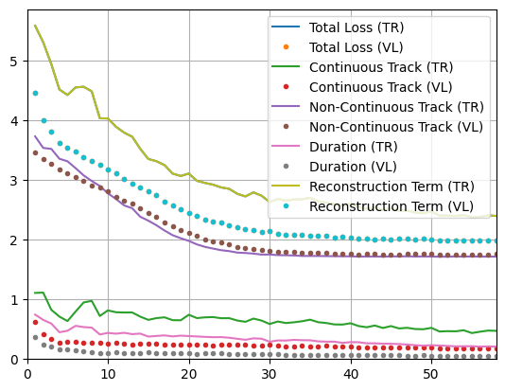
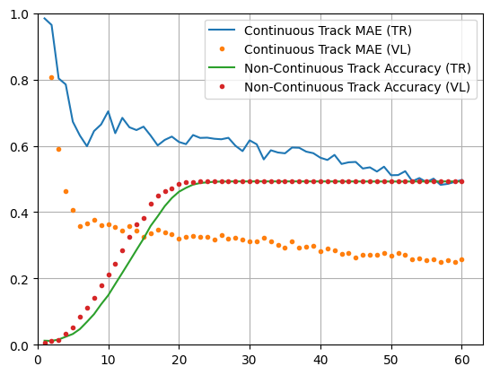
Problems and Lessons Learned
Issue: Bad categorical loss, small continuous loss
Solution: Experimented with pretrained AE, removed padding, adjusted dimensions
Lesson:
Need for careful consideration of model structure and preprocessing
Notes:
While separating the losses, I ran into the issue of categorical losses being much higher than continuous losses. I tried multiple ways to resolve this including experimenting with pretrained AE for just the categorical data, removing padding, and adjusting dimensions. The lesson here was to carefully consider dimensions and preprocessing when building the model.

Slide 15
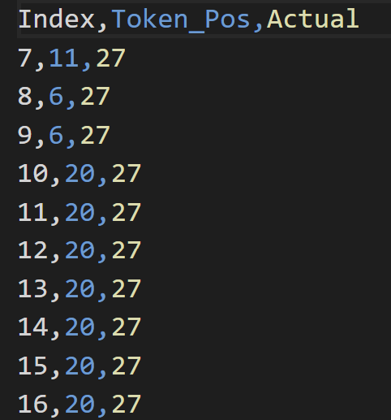
Problems and Lessons Learned
Issue: Padding and masking challenges, difficulties with variable input sizes
Solution: Built accommodating structure
Lesson:
Importance of flexible model architectures
Need to handle variable-length input data effectively
Padding token = 27
Notes:
Another related issue was padding and masking challenges. Initially, I kept the same dimensions for continuous and categorical embeddings because my input content tensor had both data types combined. I separated them in order to not have to pad and mask so that continuous data input dimensions and categorical input dimensions were different. This also resulted in splitting up categorical and continuous logits in the VAE and having separate losses for the data types. The lesson learned here was to adjust model structure from the start instead of having to have work arounds to fix dimensions.

Slide 16
Problems and Lessons Learned
Problem: Poor resampling results and slow inference (10s per sample)
MAE: 0.353
Solution: Switched to supervised method with regression network
Lesson:
Importance of considering computational efficiency
Value of adaptability in choosing modeling approaches
Notes:
Lastly, near the end of the project, I had poor resampling results (the second method in the method comparison) which showed a MAE of 0.353 which is relatively high. Inference time was also slow 10 seconds per sample so doing negative rejection sampling resulted in long computation times. The solution here was to come up with a new supervised method using a regression network. The lesson here was to understand the importance of computation efficiency and value adaptability in choosing modeling approaches.

Slide 17
Future Directions
Modify hierarchical structure, attention mechanism, way subgraphs are divided to capture:
Patterns between participants
Days at home (>80% time spent at home) vs. “other” days
Weekday vs. Weekend Analysis
Data preprocessing could contain day-type
Compare heart rate patterns, activity levels, and location preferences
Examine variations in commute patterns and urban space usage
Fine-tuning model for specific application
Enhanced Contextual Data Integration
Weather data (temperature, humidity, air pressure)
Air quality index (AQI)
Noise levels in urban areas
Local events data
Population density
Notes:
Some future directions revolve around adding problem specific and context specific information to the model. The model could benefit from modified hiearchcial structure, attention mechanisms, how subgraphs are divided to capture certain aspects such as partterns between participants and considerating days at home vs. other days separately. Another direction might be have day-types in my preprocessing to yield differences between weekday and weekend analysis. I could also spend time fine-tuning this pretrained model for analyzing specific urban areas given new data with a specific urban areas (as in freezing most layer weights, but retraining the first couple layers etc. with new data). Lastly, added context data could benefit the model as well incorporating any from the list above. Thank you again for attending my thesis defense, let me know if you have any questions, comments, or concerns.

